Slide 1
Class Diagram
Object Oriented Development
with Java
(CT038-3-2 and Version VC1)
System Modeling

Slide 2
Topic & Structure of The Lesson
Class diagram

Slide 3
Learning outcome
At the end of this lesson, you will be able to:
Model a system using a class diagram

Slide 4
Key terms you must be able to use
If you have mastered this topic, you should be able to use the following terms correctly in your assessments:
-class- association,aggregation,composition

Slide 5
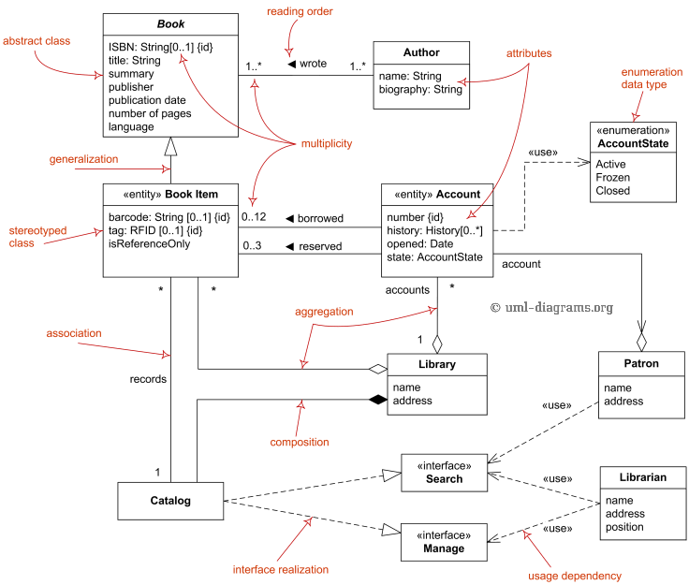
Overall Structure of a Class Diagram
Source: http://www.uml-diagrams.org/class-diagrams-overview.html

Slide 6
Class Diagram
Used for describing structure and behavior in the use cases
Provides a conceptual model of the system in terms of entities and their relationships
Used for requirement capture, end-user interaction
Detailed class diagrams are used by developers

Slide 7
Class Diagram
Class diagram models the static structure of a system. It shows relationships between classes, objects, attributes, and operations
Class
Attributes
Methods

Slide 8
Presenting Objects and Classes
Class_Human
Attributes
Methods
Class
Object of a class
Ali: Class_Human
Attributes
Methods

Slide 9
Presenting Objects and Classes
Ali
Attributes
Methods
Object
Anonymous
Object of a class
: Class_Human
Attributes
Methods

Slide 10
Attributes and Methods
<Class_Name>
AttributeName: <Data Type>
Attrib_2: <Data Type>
Attrib_3: <Data Type>
MethodName(Parameters): <Type of Value Returned>
Method_2(Parameters):<Type of Value Returned>
Method_3(Parameters):<Type of Value Returned>

Slide 11
Attributes and Methods
Human
Age: Integer
Weight: Float
Name: String
Get_Name(): String
Set_Name(String):void
Speak(String)

Slide 12
Attributes and Methods Visibility
Human
+ Age: Integer
- Weight: Float
# Name: String
.
+ Get_Name(): String
# Set_Name(String):void
~ Speak(String)
Sym | Means | Seen by
+ | Public | Any
- | Private | Own Class
# | Protected | Own and Child_class
~ | Package | Classes in the same Package
Attributes are generally hidden and methods are visible

Slide 13
OO Relationships
There are two kinds of relationships:
Generalization (parent-child relationship)
Association (student enrols in course)
Associations can be further classified as:
Aggregation
Composition

Slide 14
OO Relationships:
Association
Represent relationship between instances of classes
Student enrols in a course
Courses have students
Courses have exams
Association has two ends
Role names (e.g. enrols)
Multiplicity (e.g. One course can have many students)
Navigability (unidirectional, bidirectional)

Slide 15
Association
Lecturer
Student
Teaches >
Lecturer
Student
<studies_under

Slide 16
Association
Lecturer
Student
Teaches >
1 1
Lecturer
Student
Teaches >
1 *
Lecturer
Student
Teaches >
1 1..*

Slide 17
Association
Lecturer
Student
Teaches >
1 30
Lecturer
Student
Teaches >
1 20, 40
Lecturer
Student
Teaches >
1 1..*

Slide 18
Association Class
Just like a class, an association can have its own attributes and methods called “Association Class”
can associate with other classes
Lecturer
Student
Classroom

Slide 19
Association: Model to Implementation
*
enrols >
4
Student
Course
Class Student {
Course enrolls[4];
}
Class Course {
Student have[];
}

Slide 20
Class Diagram Associations: Aggregation
Aggregation is a strong type of association that shows that a class CAN BE PART OF another class
kind of Container- Containee relationship
Programming_Class
Student

Slide 21
Class Diagram Associations: Aggregation
Container Class
Example
Bag
Class C
AGGREGATION
Class E₁
Class E₂
Apples
Milk
Containee Classes

Slide 22
Aggregation Examples
Restaurant
Customer
Male_Child
Father
Female_Child

Slide 23
Class Diagram Associations: Composition
Composition is a stronger type of association that tells that a class BELONG TO another class.
kind of Whole-Part relationship
Human_Body
Kidney
1 1,2

Slide 24
Class Diagram Associations: Composition
Whole Class
Example
Class W
Automobile
Class P₁
Class P₂
Engine
Transmission
Part Classes

Slide 25
Composition Examples
Father
Male_Child
Female_Child
Human
Thumb_Print

Slide 26
Aggregation vs. Composition
Composition is really a strong form of aggregation
components have only one owner
components cannot exist independent of their owner
components live or die with their owner
e.g. Each car has an engine that can not be shared with other cars.
Aggregations may form "part of" the aggregate, but may not be essential to it. They may also exist independent of the aggregate.
e.g. Apples may exist independent of the bag.

Slide 27
OO Relationships:
Generalization
Supertype
Example:
Customer
Regular
Customer
Loyalty
Customer
Subtype1
Subtype2
or:
Customer
Generalization expresses a parent/child relationship among related classes.
Used for abstracting details in several layers
Regular
Customer
Loyalty
Customer

Slide 28
Generalization (Inheritance)
Child Class CAN inherit attributes and methods of the Parent Class.
Parent Class CANNOT inherit attributes and methods of the Child Class.
Child Class inherits the PUBLIC and the PROTECTED attributes and methods of the Parent Class.
Child Class WILL NOT inherit the PRIVATE attributes and methods of the Parent Class.

Slide 29
Generalization (Inheritance)
Super Class / Parent Class
Living_Creatures
Children Class / Subclass
Human
Animals
Plants
Bacteria

Slide 30
Overall Structure of a Class Diagram
Name
Order
class
Multiplicity: mandatory
Attributes
-dateReceived
*
Customer
-isPrepaid
1
-number :String
-name
-price : Money
-address
Operations
+dispatch()
Association
+creditRating() : String()
+close()
1
{if Order.customer.creditRating is
Generalization
"poor", then Order.isPrepaid must
be true }
Corporate Customer
Personal Customer
Constraint
(inside braces{}}
-contactName
-creditCard#
-creditRating
Multiplicity:
Many value
-creditLimit
+remind()
+billForMonth(Integer)
Multiplicity: optional
0..1
*
*
Employee
OrderLine
-quantity: Integer
*
1
Product
-price: Money
-isSatisfied: Boolean
Source: Fowler (1997) - UML Distilled (3rd edition)

Slide 31
Exercise
Draw a class diagram for the following scenario:
A car rental company wants to develop an automated system that would handle car reservations, customer billing, and car auctions.
Normally, a customer reserves a car, picks it up, and then returns it after a certain period of time. At the time of pick up, the customer has the option to buy or waive collision insurance on the car. When the car is returned, the customer receives a bill and pays the specified amount. In addition to renting out cars, every six months or so, the auto rental company auctions the cars that have accumulated over 20,000 miles.

Slide 32
Quick Review Questions
What is a class diagram?
What are the components of a class diagram?
Draw the class diagram for borrowing a book from the library

Slide 33
Summary of Main Teaching Points
-Class diagram and its componets

Slide 34
Q & A

Slide 35
Next Session
-Activity diagram

